Slide 1
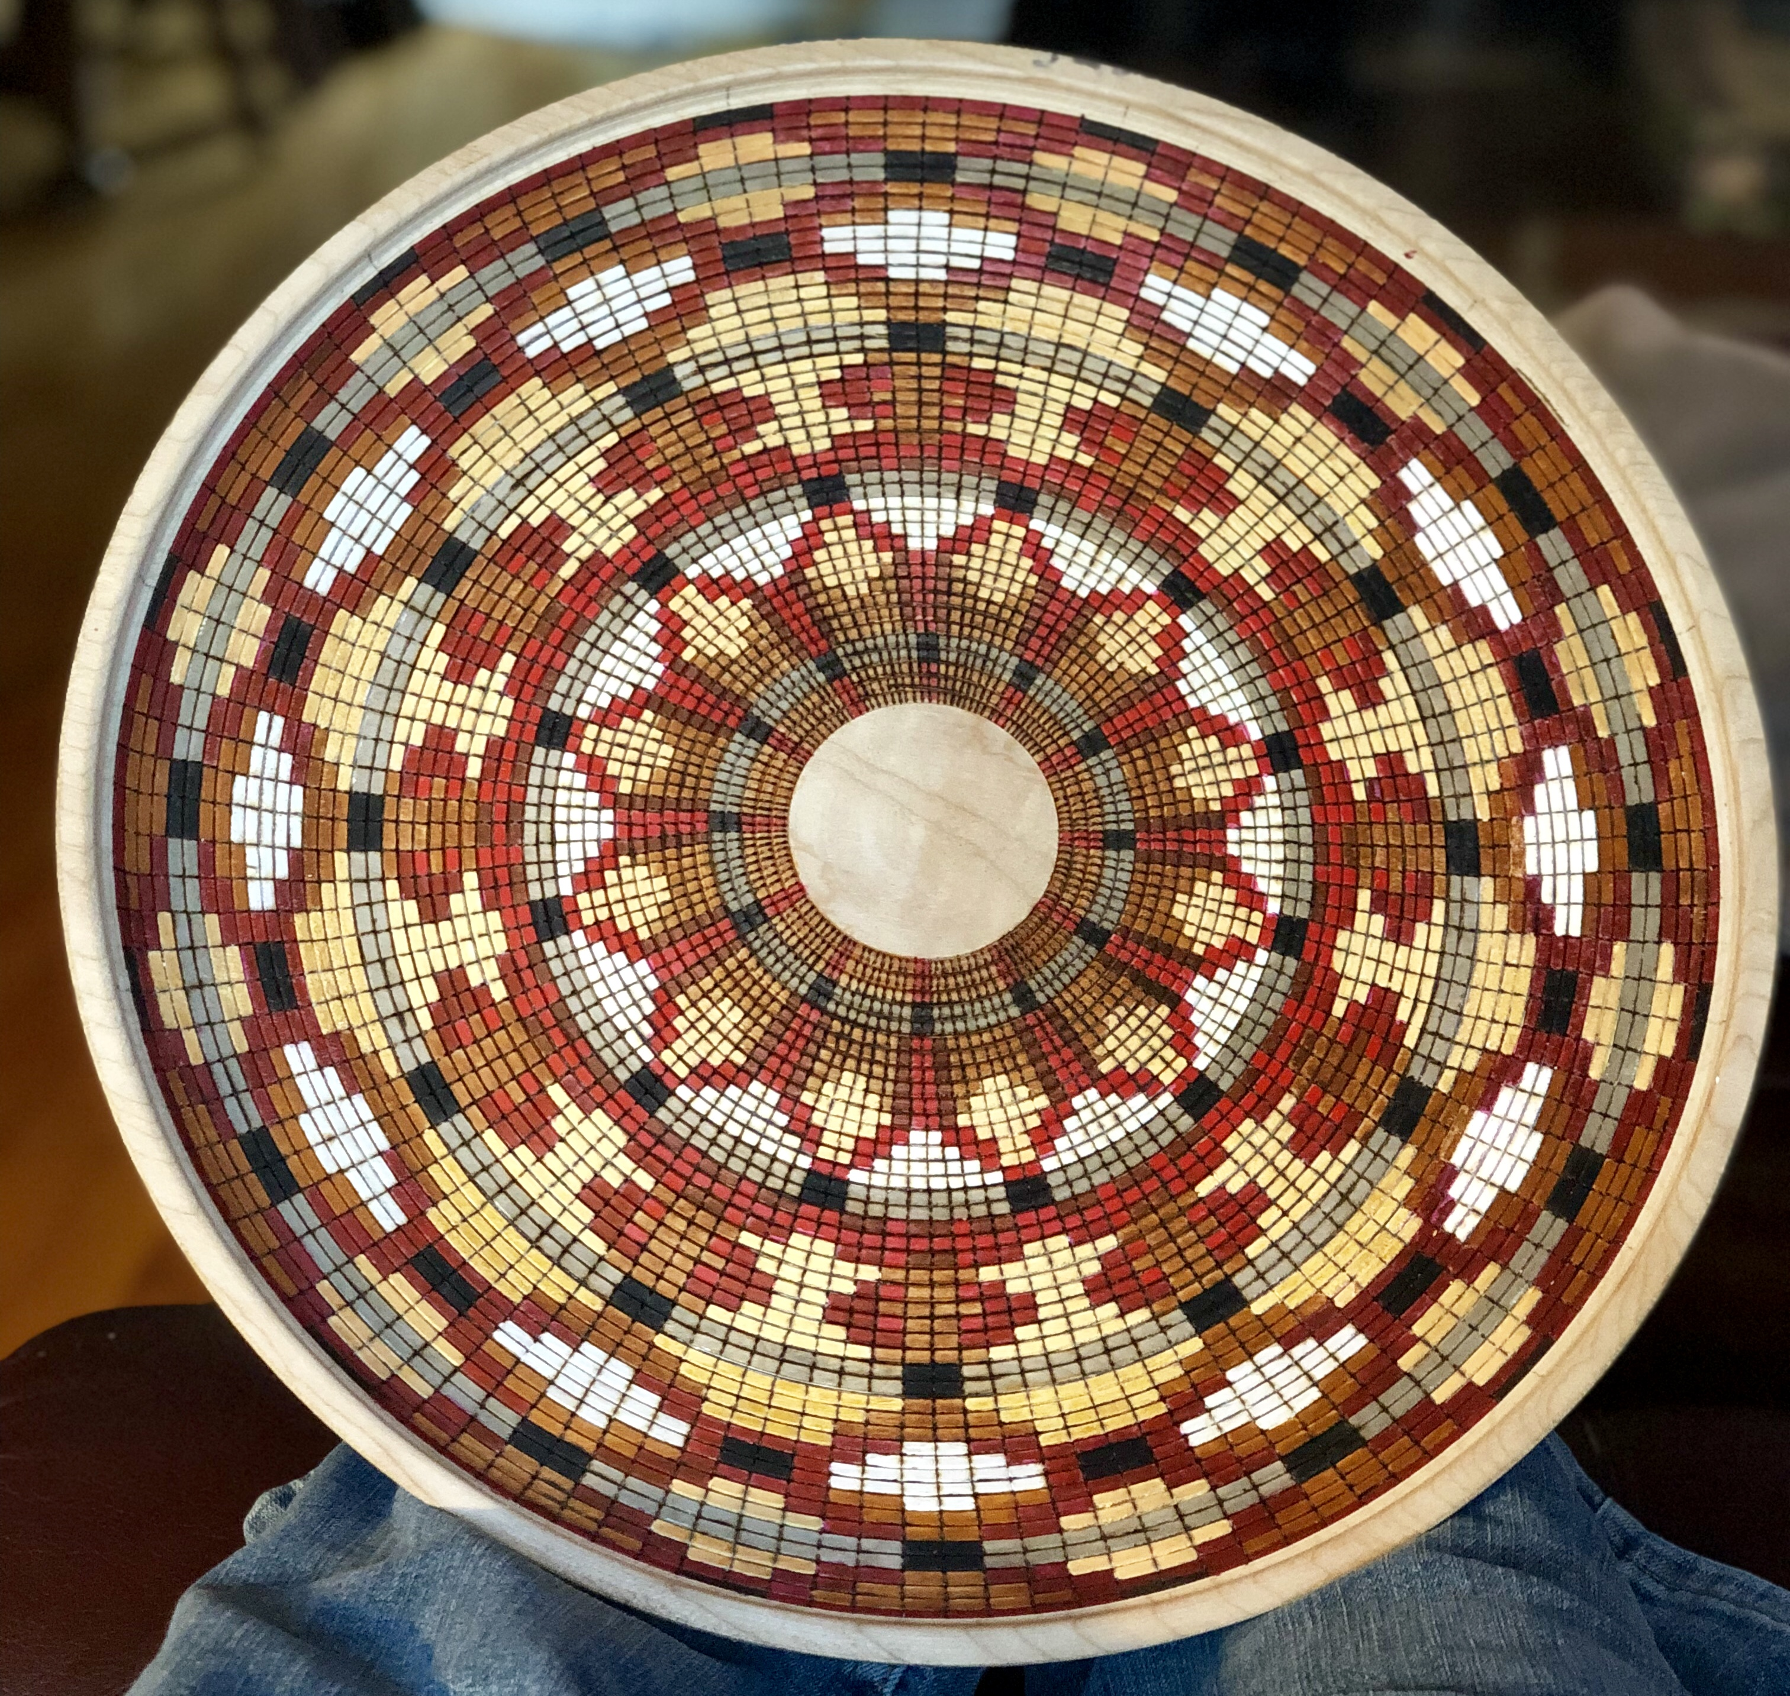
Basket Illusion
Betty Simnitt

Slide 2
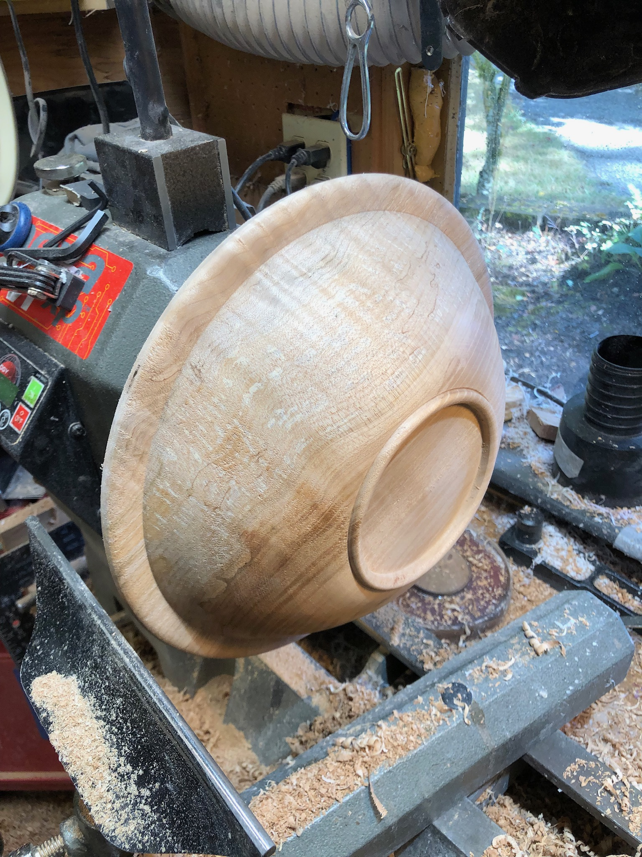
Getting Prepared
What wood to use –
I prefer hard maple – especially if I intend to use a lot of color – it seems to take the beading well, and it holds color well.
Tools –
Bowl gouge
Skew
Beading tool
Indexing wheel
Wood burning tools
Brush tipped markers

Slide 3
Getting Started
Turn a bowl !
Remember that the shape you choose will also determine the degree of difficulty you will have in beading as well as the pyrography work , and the painting work
Size of the bowl is strictly your option

Slide 4
Next Step
I turn the back of the bowl and leave a mortise to get a good hold with the chuck.
Leave the bowl mounted and finish the back side as you would any other bowl.
Sand 120, 180, 240 – be sure to pay close attention to the end grain areas as if they are left rough they will cause difficulty in beading and in pyro work.

Slide 5
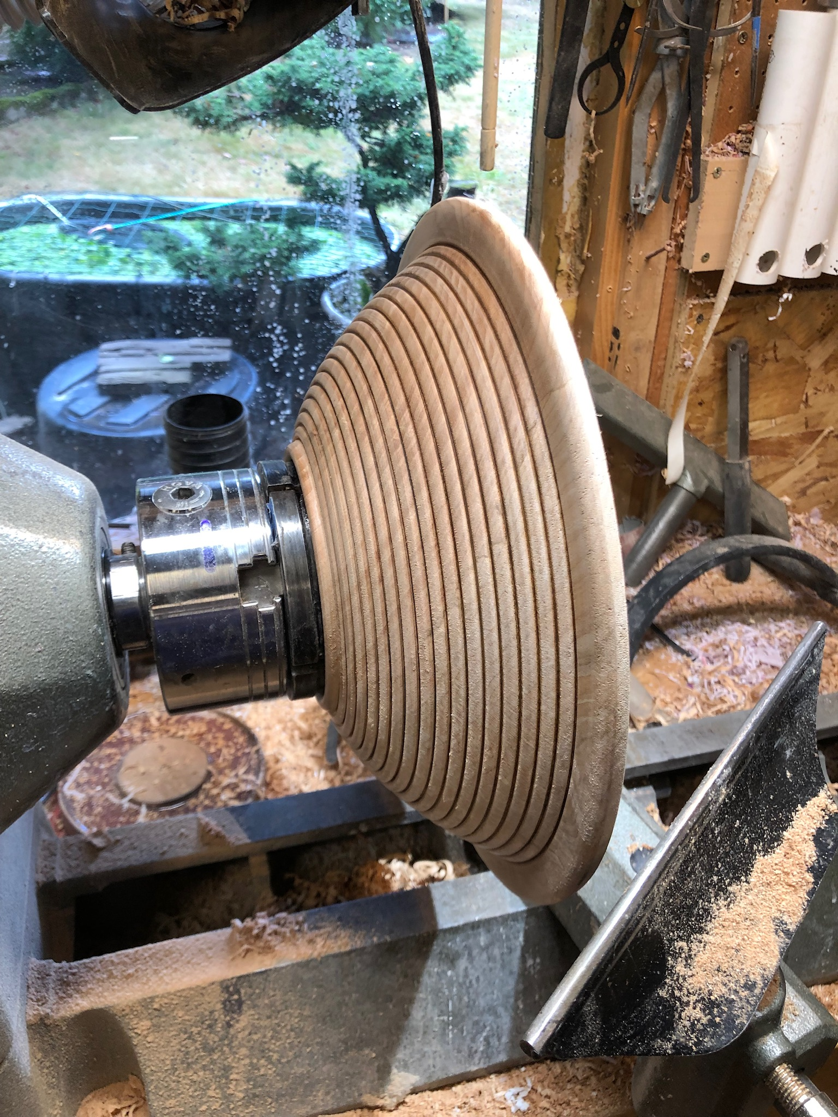
Beading the back
Bead the back of the bowl using care with making each bead.
Light pass at first – then come back and refine each bead
TAKE YOUR TIME !!!!
Once happy with the beading – flip the bowl around and mount on the chuck

Slide 6
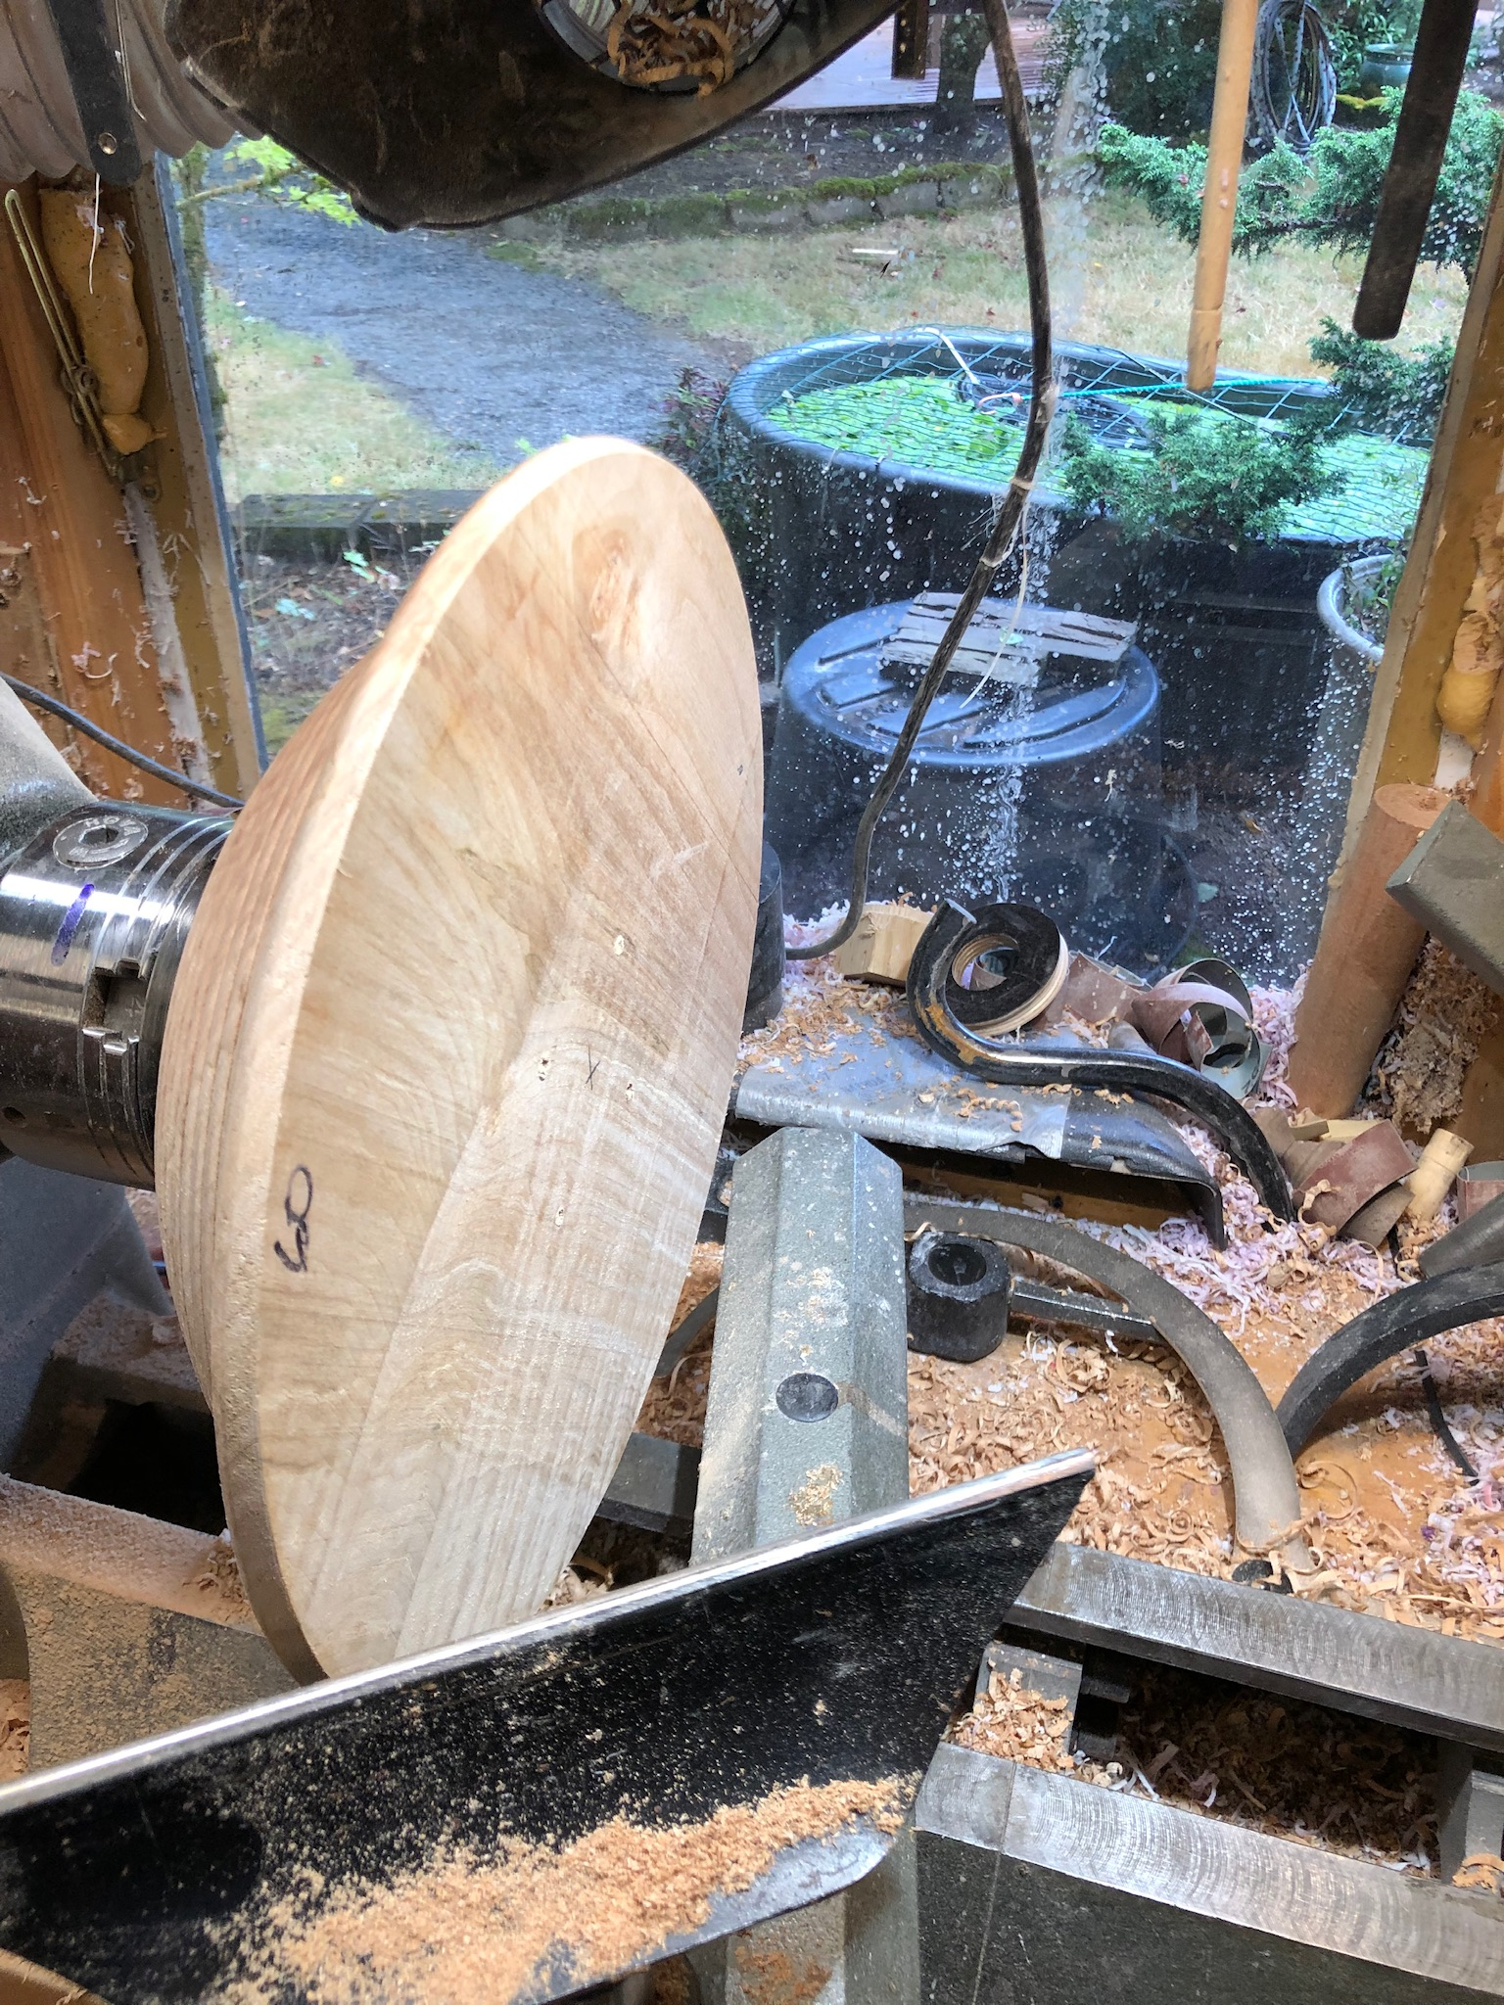
Turn the inside of the bowl
Turn the inside of the bowl
Following the contour of the outside of the bowl.
Sand as before
Bead as before - pay close attention to the number of beads you have on the outside and use that number on the inside

Slide 7
Time for Indexing
Remove the bowl and the chuck in one piece and set up your indexing rig.
This part has to have your attention to detail, and will initially test your patience.
Decide if you will burn the index lines in or pencil them in.
Once indexing is done – time to design your basket -unless you already have.

Slide 8
Design Tips
Personally I try hard not to re-use other peoples designs.
I do not necessarily follow a native American or Ethnic theme.
Find a design method that works for you.
Paper - I-Pad design program GRIDMAKER

Slide 9
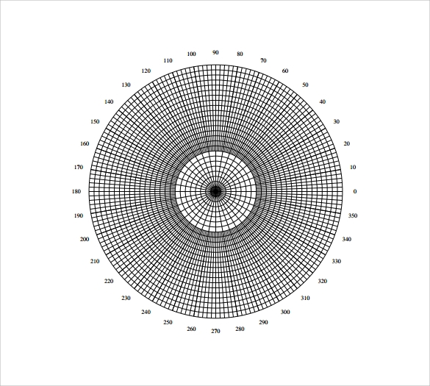
Design Example

Slide 10
References
Indexing Plates :
www.alisam.com
Paulhowardwoodturner.com.uk
Markers :
Arteza Markers – Water based
ZIG – Kuretake – Water based

